Slide 1

VLAN and Inter-VLAN Routing with FortiGate
Mohamed Karem Ali (Team Leader) – Youssef Ayed Youssef Ashyry – Eyad Ashraf Ahmed –
Micheal George Ibrahim wadeh –Mohamed Yasser Moustafa Mohamed

Slide 2
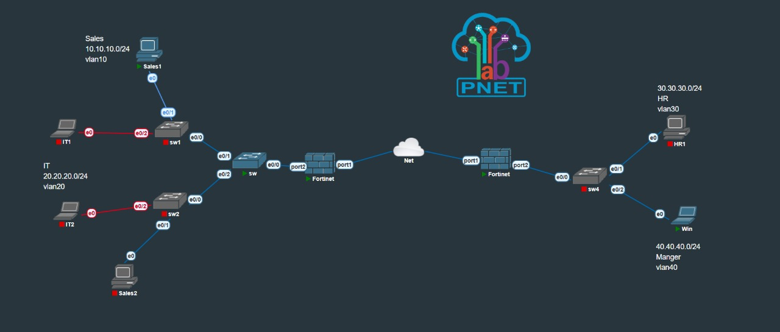
Network Topology & IP Plan
Core Components
Switches (SW1, SW2, SW4) manage LAN segmentation.
FortiGate 60F acts as the core router and firewall.
VLANs are distributed across switches to isolate departments.
VLAN Distribution
VLAN10: Sales (192.168.10.0/24)
VLAN20: IT (192.168.20.0/24)
VLAN30: HR (192.168.30.0/24)
VLAN40: Manager (192.168.40.0/24)

Slide 3
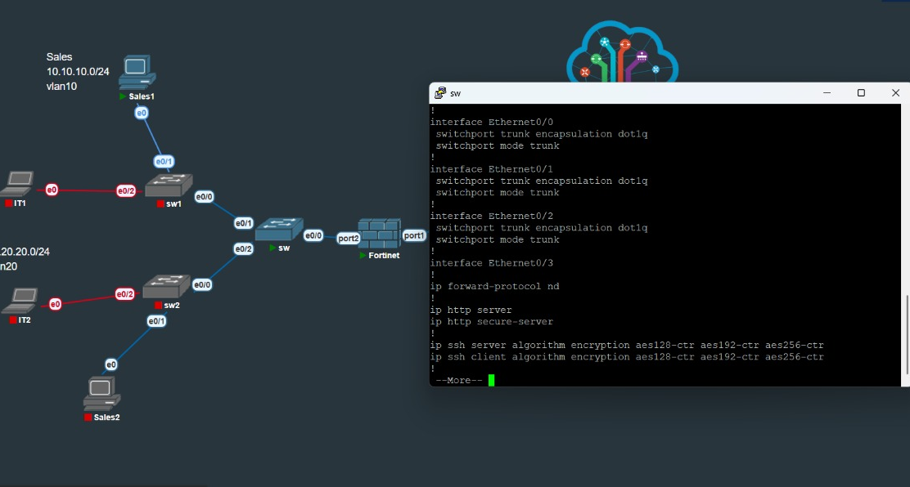
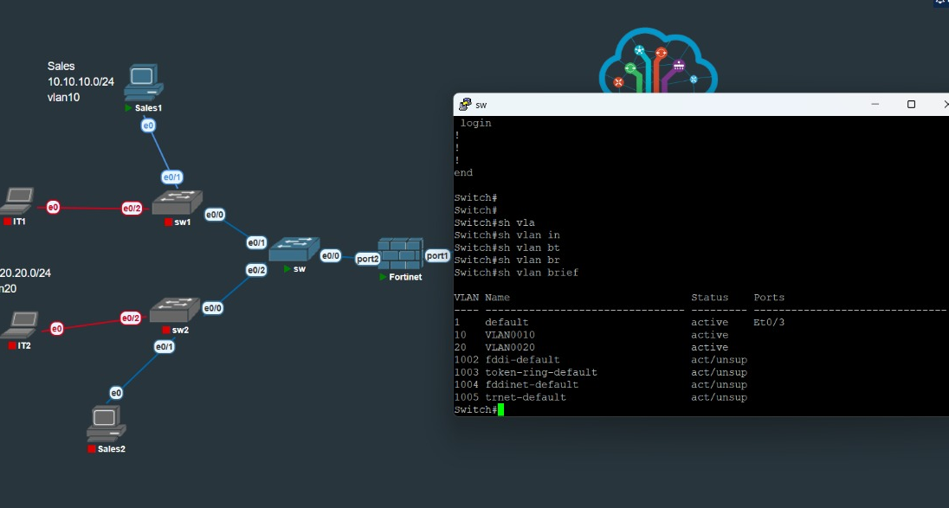
Switch Config: Trunk & VLAN DB
Trunk ports configured for 802.1q (dot1q) tagging to carry all VLANs.
VLAN database is active and populated on all switches in the topology.

Slide 4
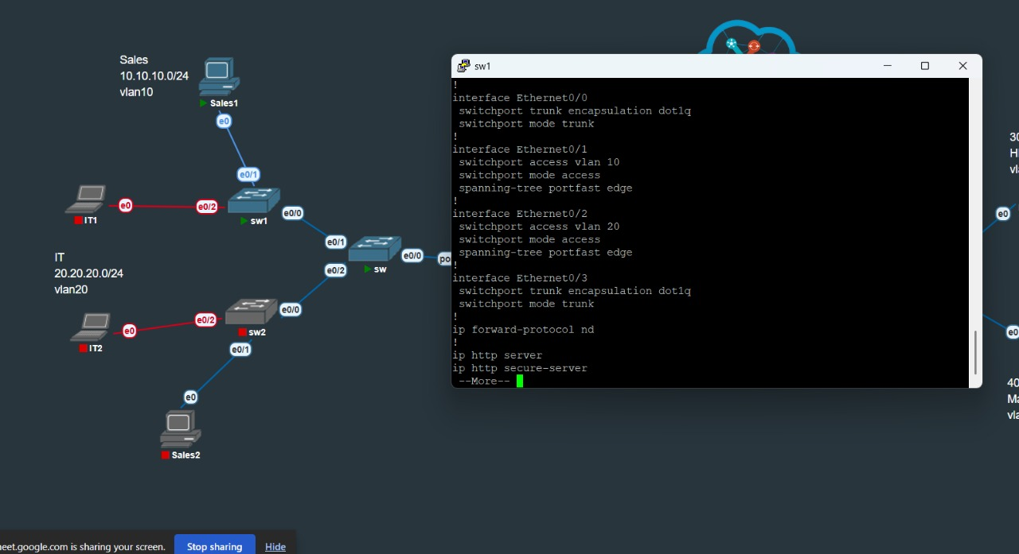
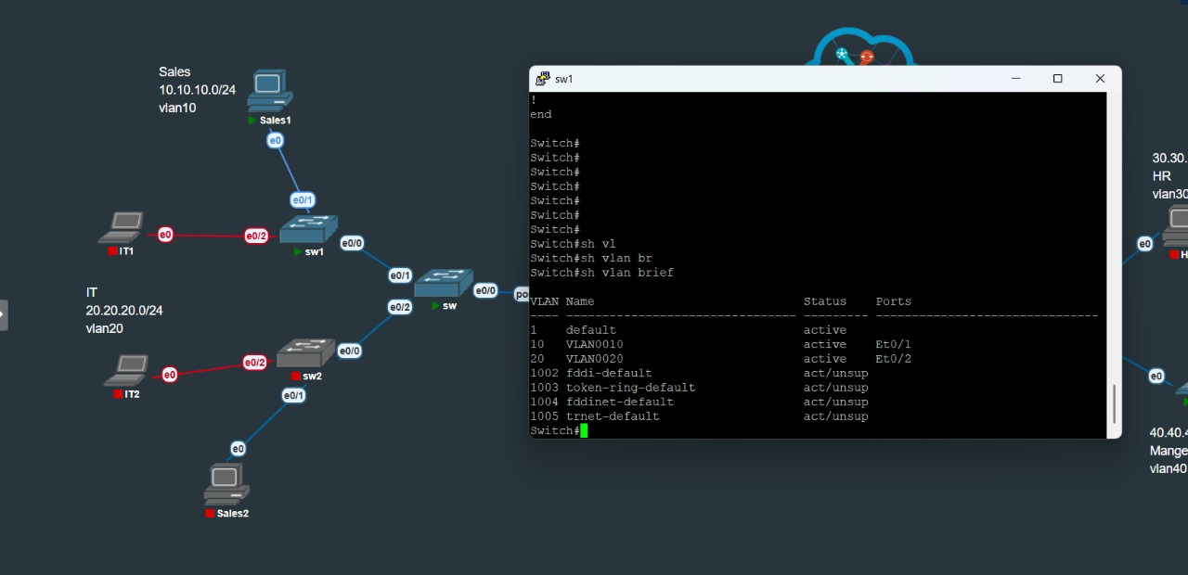
SW1 & SW2 VLAN Brief
SW1 carries VLAN10 (Sales) and VLAN20 (IT). Access ports are assigned accordingly.
SW2 also carries VLAN10 (Sales) and VLAN20 (IT), providing departmental redundancy.

Slide 5
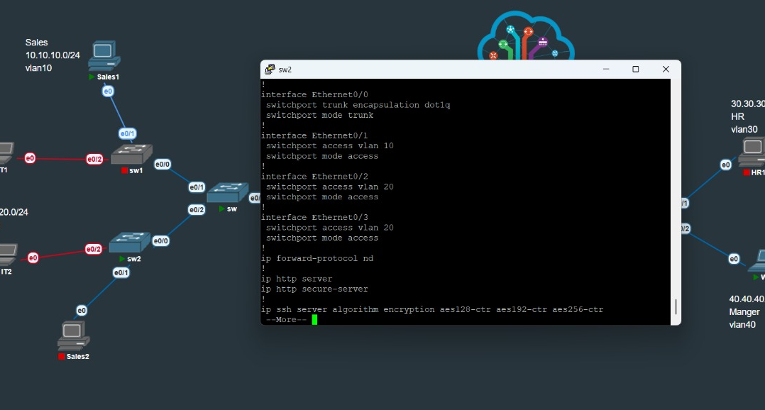
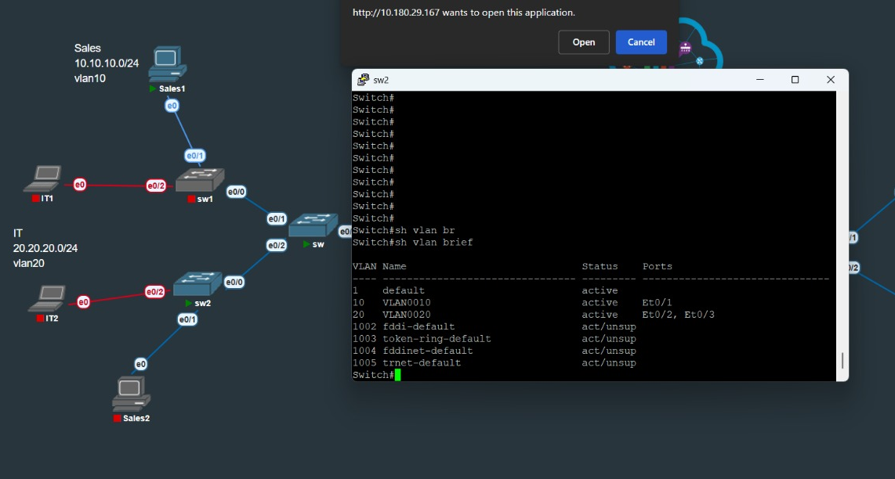
SW4 Configuration
SW4 is configured for VLAN30 (HR) and VLAN40 (Manager).
Access and trunk ports are assigned to connect to endpoints and the core.

Slide 6
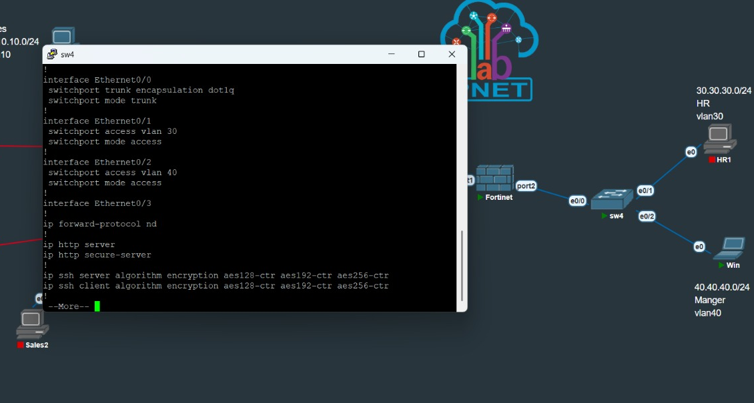
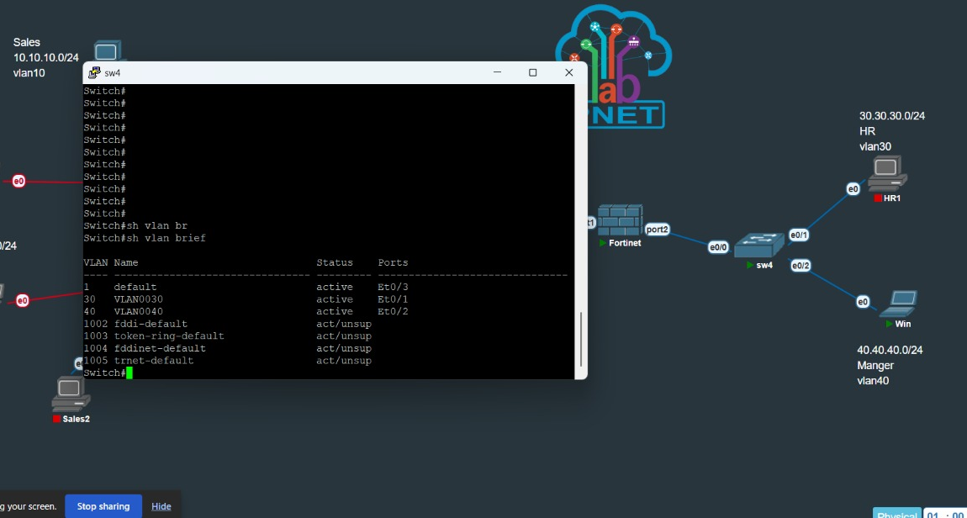
Switch CLI Configuration
Summary of SW1 CLI configuration, showing interface status and VLANs.
Summary of SW2 CLI configuration, mirroring SW1 for redundancy.

Slide 7
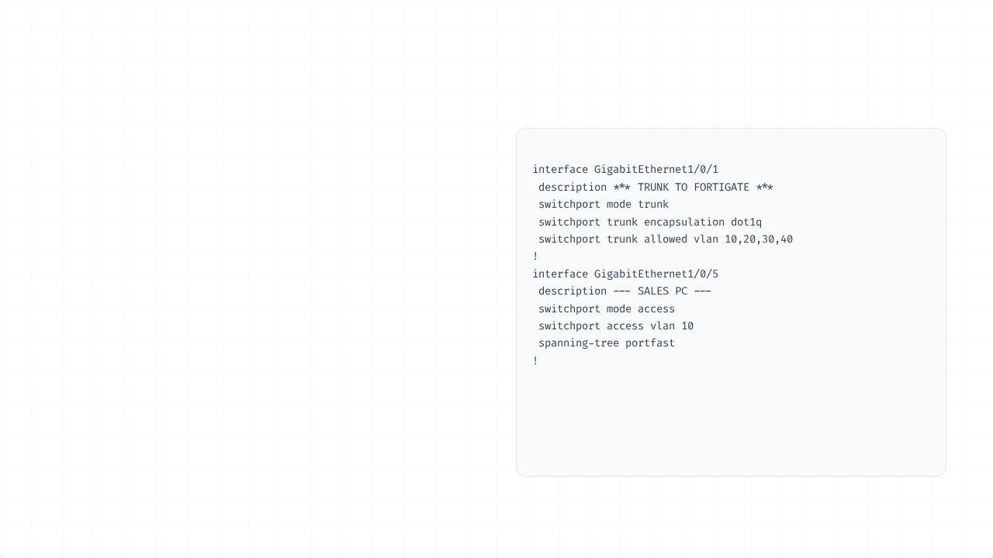
Switch CLI – Code Example
Trunk Port (to FortiGate)
interface GigabitEthernet1/0/1
switchport mode trunk
switchport trunk encapsulation dot1q
switchport trunk allowed vlan 10,20,30,40
Access Port (e.g., Sales)
interface GigabitEthernet1/0/5
switchport mode access
switchport access vlan 10
spanning-tree portfast

Slide 8
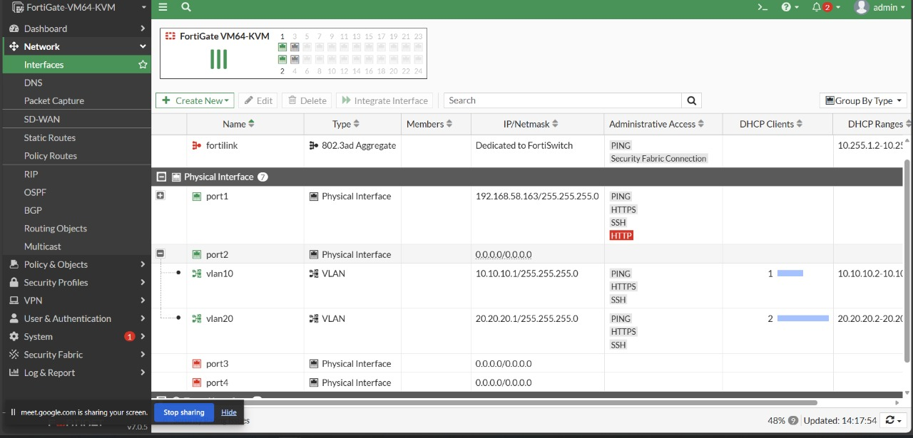
FortiGate VLAN Interfaces (1)
Physical & Virtual Interfaces
WAN interface (wan1) configured for external access.
Internal port (e.g., internal) acts as the parent for VLAN sub-interfaces.
Sub-interfaces created for each VLAN (VLAN10, VLAN20, VLAN30, VLAN40).
Each sub-interface acts as the gateway for its respective VLAN.
DHCP server is enabled on each VLAN interface.

Slide 9
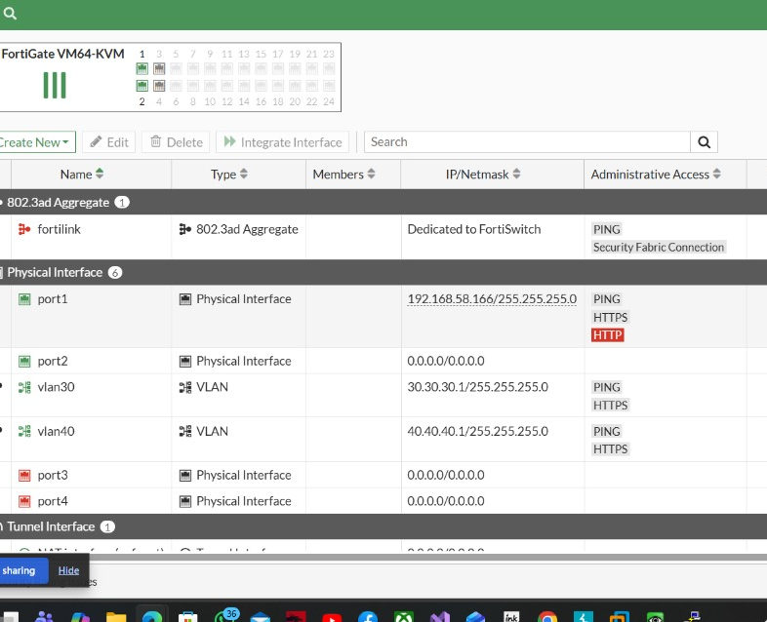
FortiGate VLAN Interfaces (2)
DHCP Server Configuration
DHCP scopes are defined for all four VLANs to provide automatic IP addressing to endpoints.
VLAN10 (Sales): 192.168.10.10 - 192.168.10.100
VLAN20 (IT): 192.168.20.10 - 192.168.20.100
VLAN30 (HR): 192.168.30.10 - 192.168.30.100
VLAN40 (Manager): 192.168.40.10 - 192.168.40.100

Slide 10
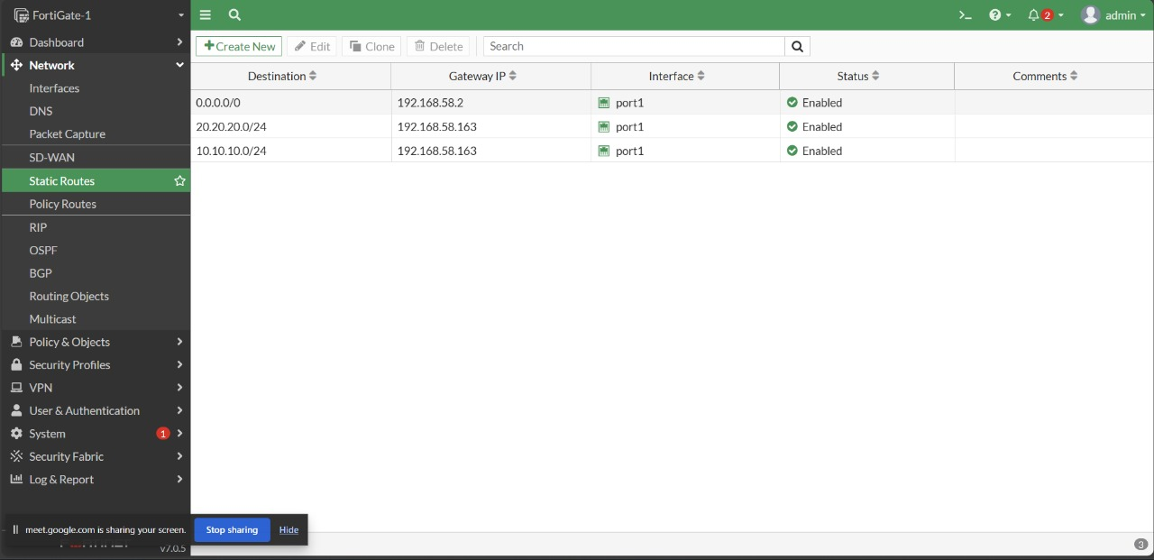
Static Routes
Routing Configuration
A default static route (0.0.0.0/0) is configured to point all outbound traffic to the WAN interface gateway.
Internal routes (connected routes) are automatically created for each VLAN sub-interface, enabling the FortiGate to route between them.

Slide 11
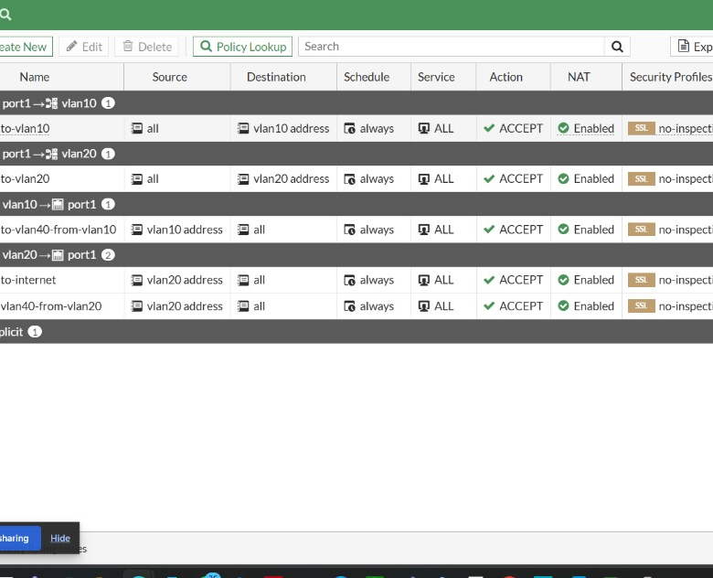
Firewall Policies
Inter-VLAN Policies
Policy 1: Allows traffic between VLAN10 (Sales) and VLAN20 (IT).
Policy 2: Allows traffic between VLAN30 (HR) and VLAN40 (Manager).
NAT (Network Address Translation) is disabled on these internal policies to allow true routing and visibility of source IPs.
A separate policy handles Internet-bound traffic (NAT enabled).

Slide 12
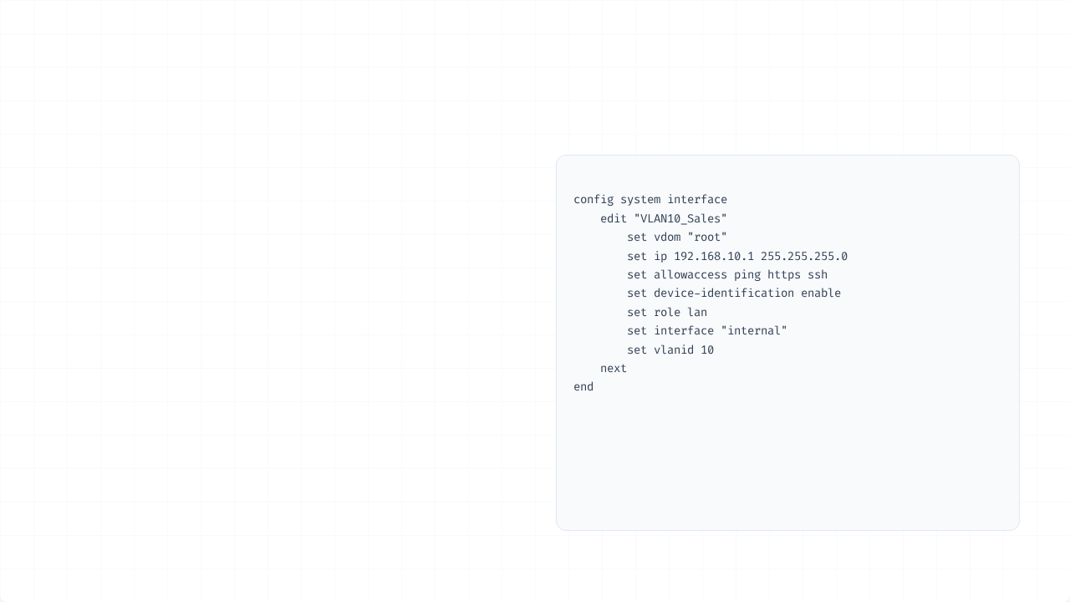
FortiGate CLI – Interfaces
VLAN Sub-interface CLI
Example configuration for creating a VLAN interface via the FortiGate CLI.
This method is fast, scriptable, and provides full access to all options.

Slide 13
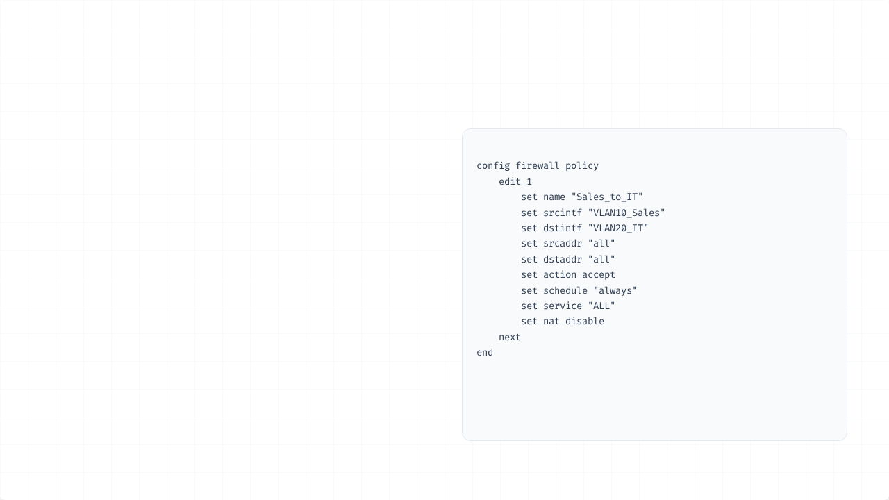
FortiGate CLI – Policy
Inter-VLAN Policy CLI
Example CLI configuration for an internal firewall policy.
Note that nat disable is explicitly set.

Slide 14
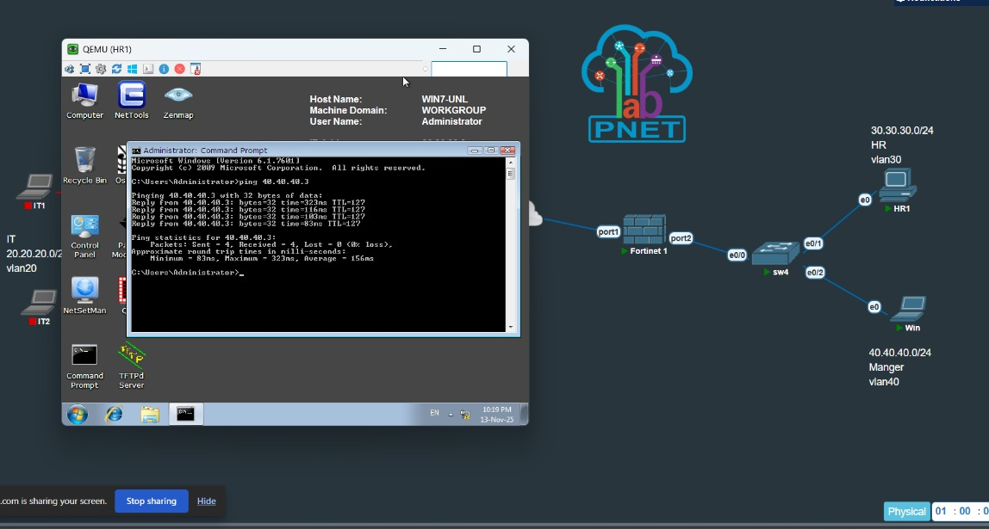
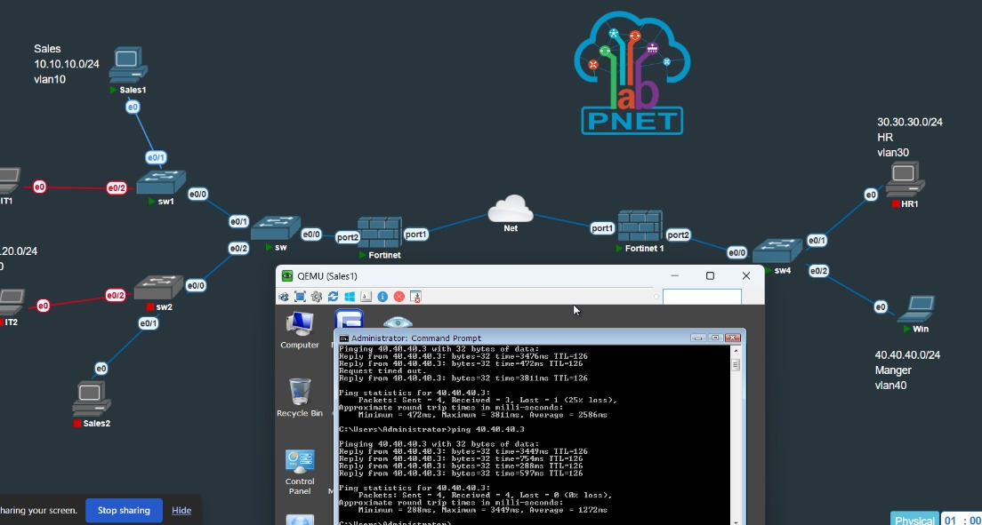
Connectivity Test: HR ↔ Manager
Successful ping from HR (VLAN30) to Manager (VLAN40).
Successful ping from Manager (VLAN40) to HR (VLAN30).

Slide 15
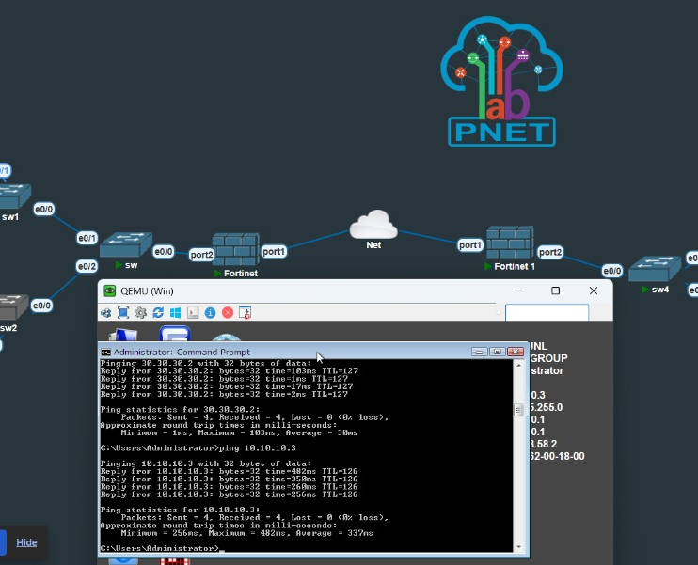
Connectivity Test: Manager ↔ Sales
Cross-Department Ping
A connectivity test is initiated from the Manager VLAN (VLAN40) to the Sales VLAN (VLAN10).
Result: The ping fails as intended. This demonstrates successful segmentation, as no firewall policy exists to allow this specific traffic path.

Slide 16
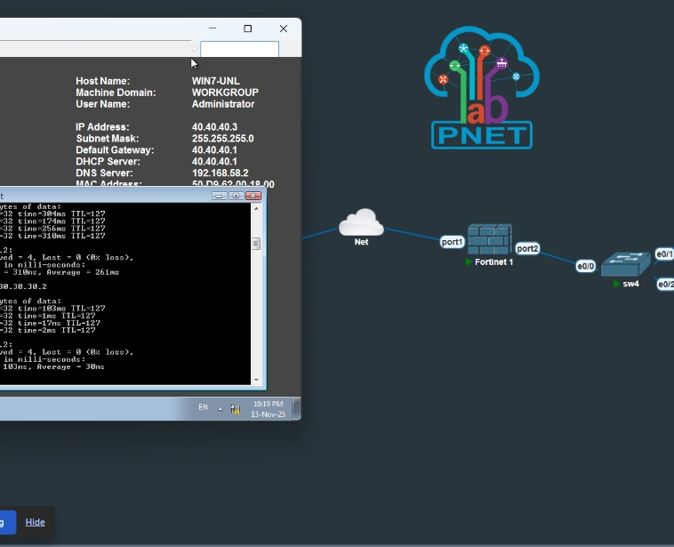
Internet Access (Manager)
Internet Access Policy
A firewall policy is created from all internal VLANs (LAN) to the wan1 (WAN) interface.
NAT (Network Address Translation) is enabled on this policy, allowing all internal devices to share the single public IP.
Test: Successful ping from Manager (VLAN40) to 8.8.8.8.

Slide 17
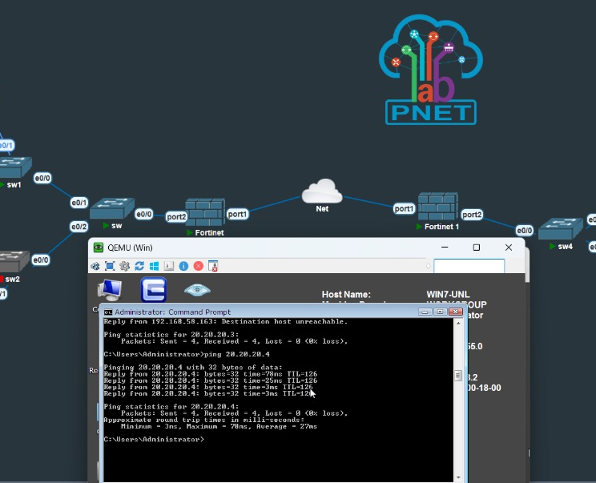
Final Ping – IT VLAN
Full Connectivity Test (IT)
The IT VLAN (VLAN20) is tested for full connectivity:
▪
Test 1: Ping to Sales (VLAN10) - Success
▪
Test 2: Ping to HR (VLAN30) - Fail (As expected)
▪
Test 3: Ping to Gateway (192.168.20.1) - Success
▪
Test 4: Ping to Internet (8.8.8.8) - Success

Slide 18
Observations & Best Practices
Trunk Tagging: 802.1q trunking is essential for carrying multiple VLANs over a single link to the firewall.
Sub-interfaces: FortiGate sub-interfaces are the key to enabling Layer 3 inter-VLAN routing.
NAT Behavior: NAT must be disabled for internal inter-VLAN policies but enabled for Internet-bound policies.
DHCP per VLAN: FortiGate's built-in DHCP server simplifies IP management for each segment.
Portfast: Enabled on switch access ports to bypass Spanning Tree states and speed up device connectivity.
Performance: Lab results show stable latency and 0% packet loss on all successful connectivity tests.

Slide 19
Thank You
Questions?

